Slide 1


TEXT MINING ON USER REVIEWS
TO STUDY USER CONCERNS
Group - 3
Abhijith Antony
Hridhay Mehta
Sanjay Jayakumar
Vishnu Vijayakumar

Slide 2
Objective
Exploration of the fields of NLP & Text Mining
Business Recommendation : Employ topic modeling techniques to extract major concerns that the users have about a brand/product (vis-à-vis battery life, design etc.)
Academic Exploration : Predict user ratings based for cell phones on their reviews

Slide 3







Approach
Data sourcing
Data Cleaning & Manipulation
Exploration of the dataset
Sentiment Analysis
Topic Modeling
Predictive Model

Slide 4
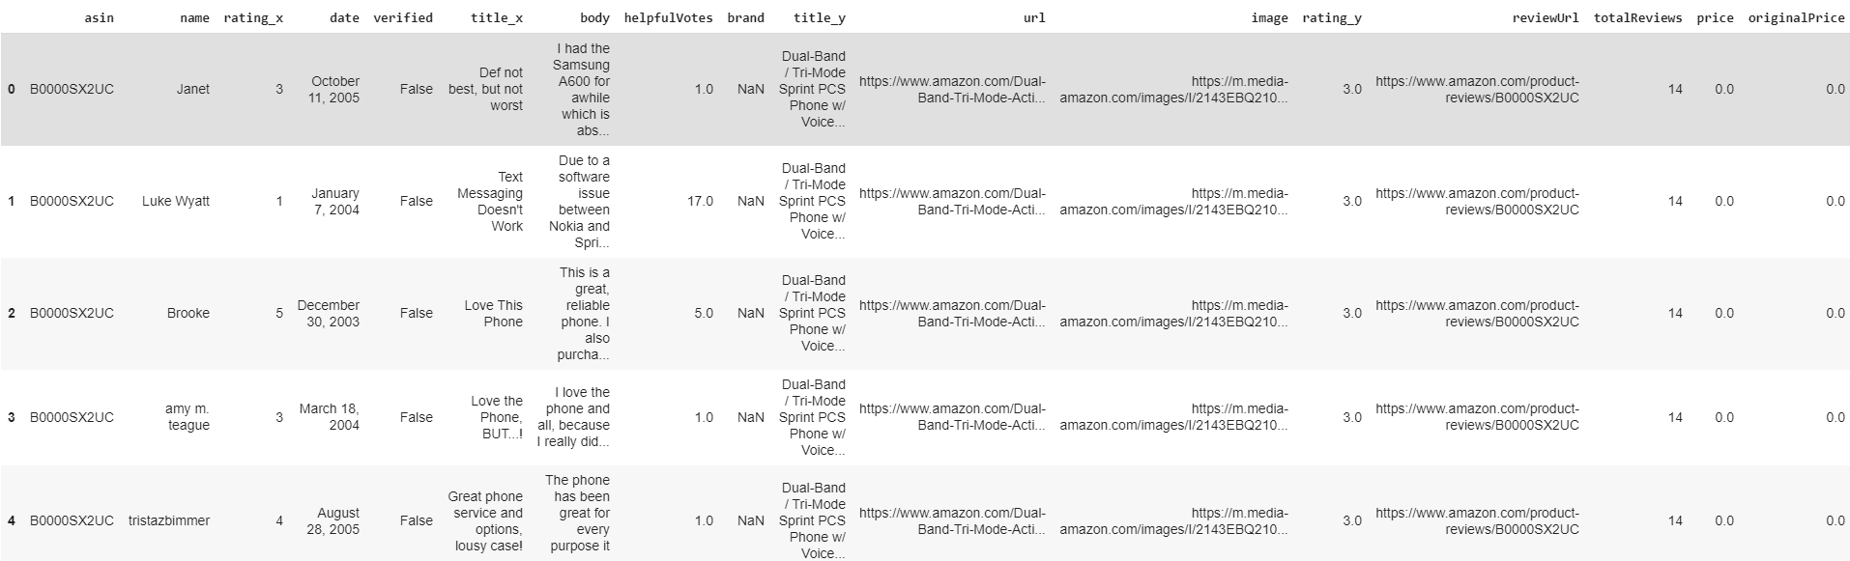
Data sourcing
Source: Amazon cell-phone reviews dataset from kaggle
items :
Pre-scraped data for select 720 phones items
reviews: ~68000 reviews for phone brands in items
merged data

Slide 5
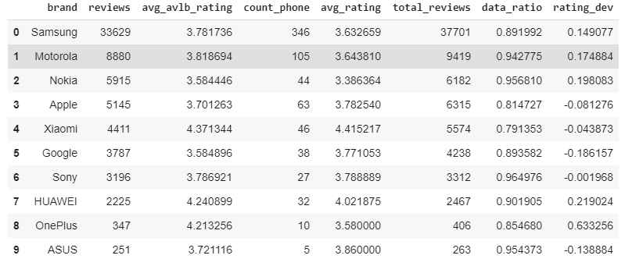
Exploration of the dataset
We have 67986 reviews with 17 features.
40% of the reviews are for Samsung.
Samsung, Motorola, Nokia and Apple have less than 0.2 rating deviation.

Slide 6
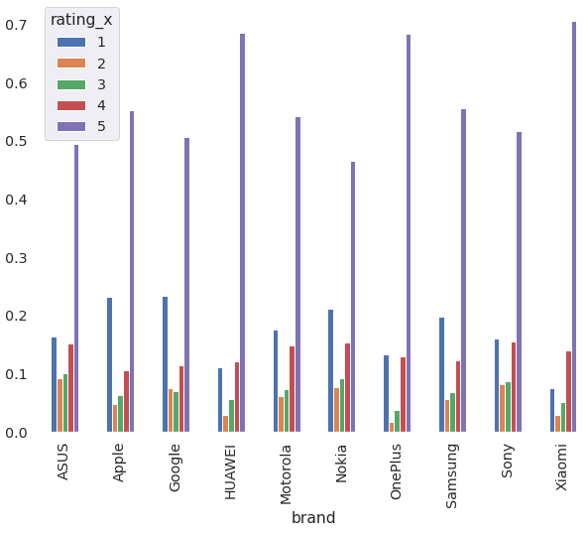
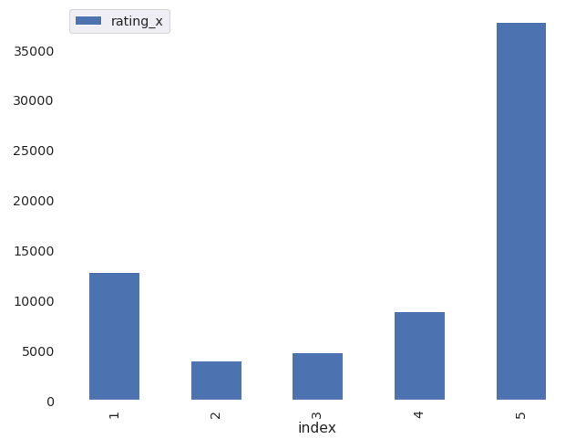
Exploration of the dataset : Distribution of Rating
~67% of ratings are 4 & 5 in general
This is the same for all the brands as well

Slide 7

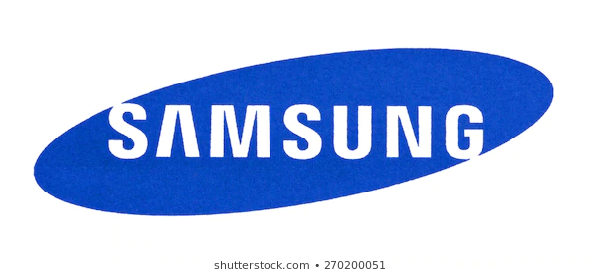

The Companies that we focus on
For this analysis, we focus on 3 major Smartphone companies:
Together, they constitute ~65% of the total smartphone market

Slide 8
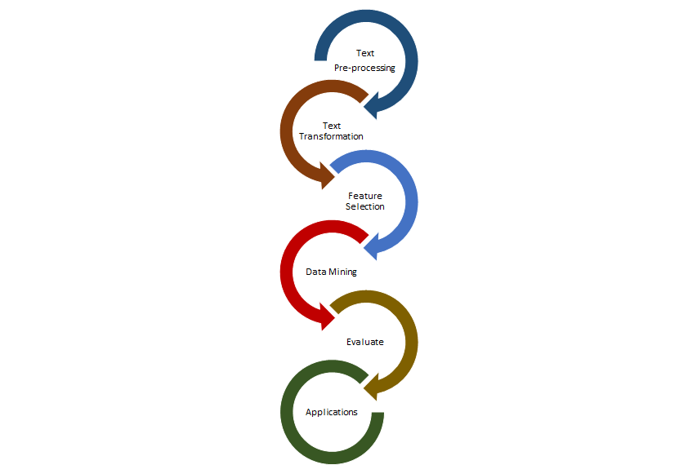
Text Mining
Extracting structured information from unstructured text using natural language processing
High-value knowledge discovery in various areas of application
R&D, competitive intelligence, patent analysis and market research using sentiment analysis and social media mining
Algorithms include Entity extraction, Information retrieval, Categorization, Clustering, Summarization

Slide 9

Sentiment Analysis
Helps organizations understand the social sentiment of their brand, product or service while monitoring online conversations / reviews
Input : Corpus - A collection of words where order matters.
Output :
Sentiment score ranging from -1 to 1 (which is polarity)
Subjectivity score of 0 to 1 where 0 indicates a fact and 1 indicates an opinion.

Slide 10
Sentiment analysis
Libraries used
Text Blob
Python-based open source library
Output : Tuple, polarity, and
subjectivity
Polarity lies within -1.0 & 1.0
Polarity > 0 = positive
Polarity < 0 = negative
VADER
Valence Aware Dictionary & Sentiment
Protected under MIT license
Output : Polarity score in dictionary
format
Evaluates probability of a positive, negative or neutral sentiment.
If P(positive) is more, label = positive
Else, label = negative

Slide 11
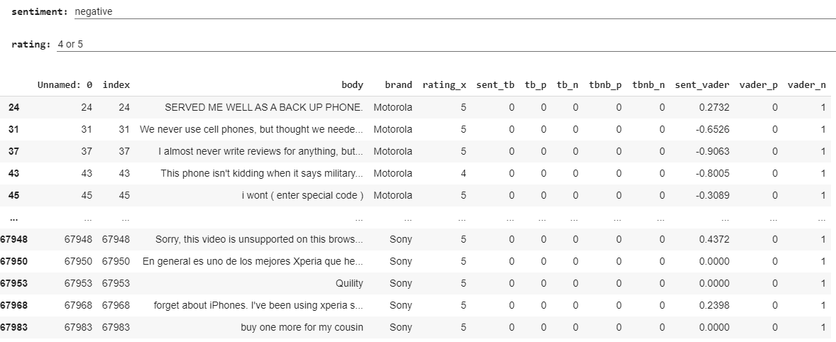
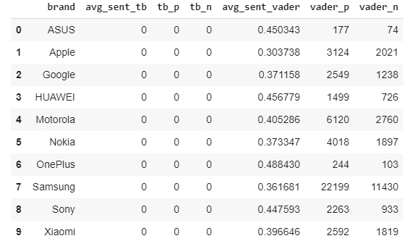
Sentiment analysis

Slide 12
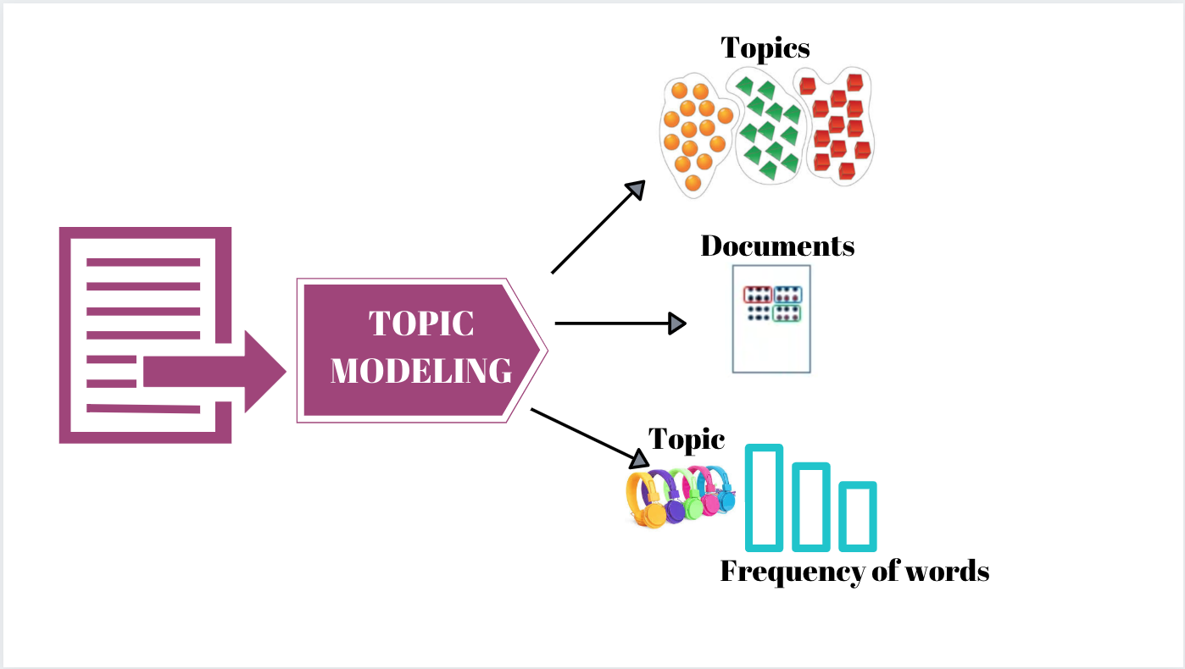
Topic Modeling
Discovers abstract “topics” in a collection of documents
Automatically “learns” groups or clusters of words that best characterize the data
Major algorithms
Latent Dirichlet Allocation
Structural Topic Models
Non-negative matrix factorization

Slide 13
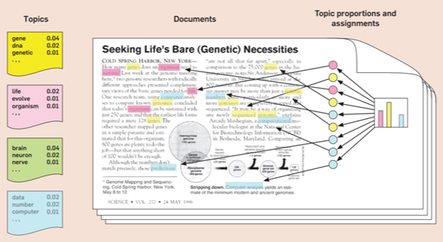
Linear Dirichlet Allocation
Concept : Each document can be described by a distribution of topics
Each topic can be described by a distribution of words

Slide 14
Visualizing the findings of LDA Model
Our analysis is focussed on these 3 companies : Samsung, Apple and Xiaomi.
The subsequent slides will show the following 2 aspects on a brand-wise level
Word cloud of top 10 words in each topic
The most discussed topics in the documents
By weight in that document
By summing up the weight contribution of each topic to the document

Slide 15

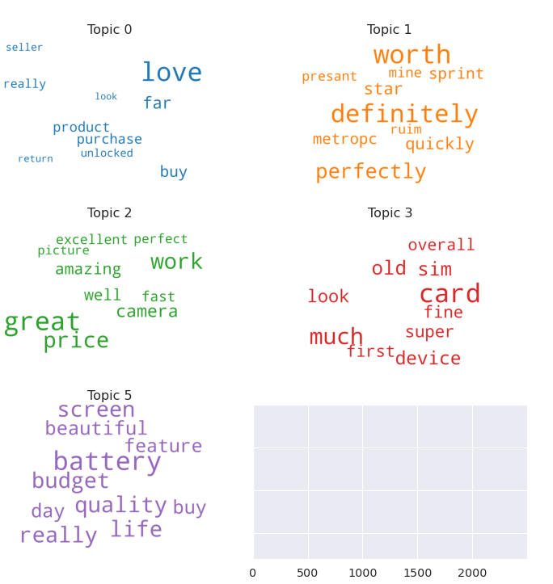
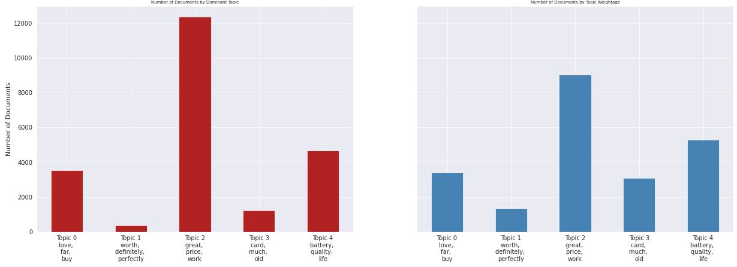
Positive comments
Word cloud
Most Discussed Topics
by dominant topic
by topic weightage
Takeaways:
Users tend to love their purchase experience
User find the product worth the money spent
Users like the quality & durability of product

Slide 16

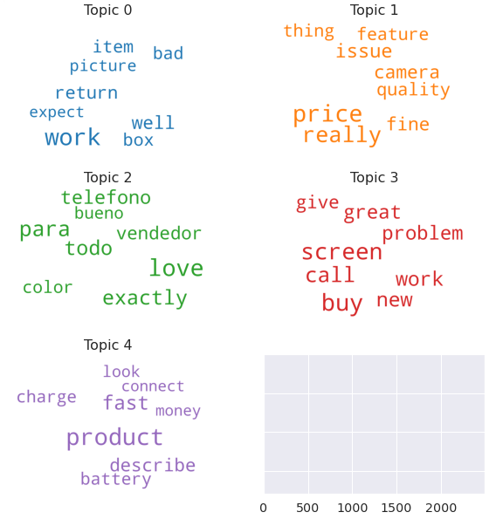
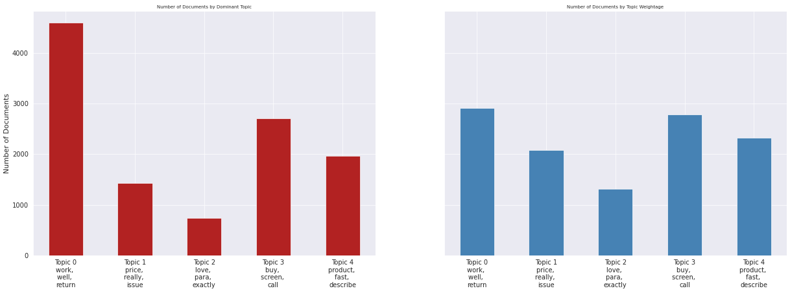
Negative comments
Word cloud
Most Discussed Topics
by dominant topic
by topic weightage
Takeaways:
Users have an issue with the working of product such as heating issue
Users have problems with camera , screen etc
Users do not find the product to be fast

Slide 17
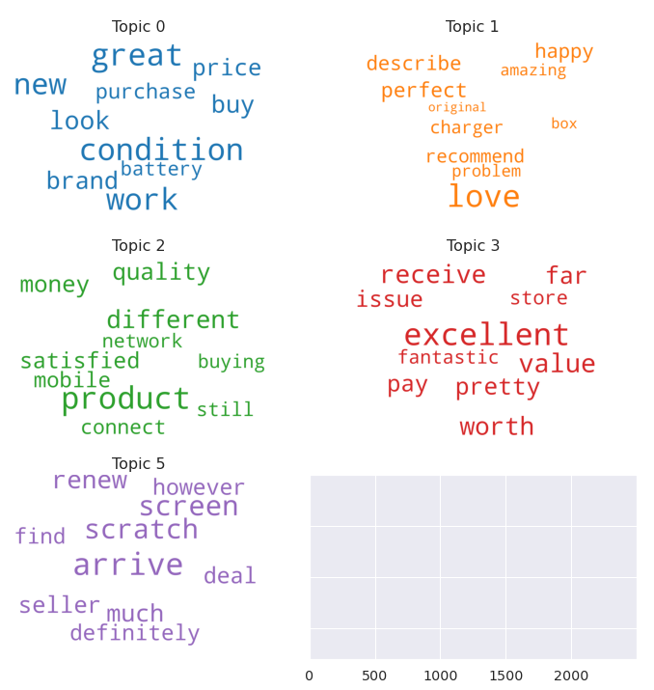
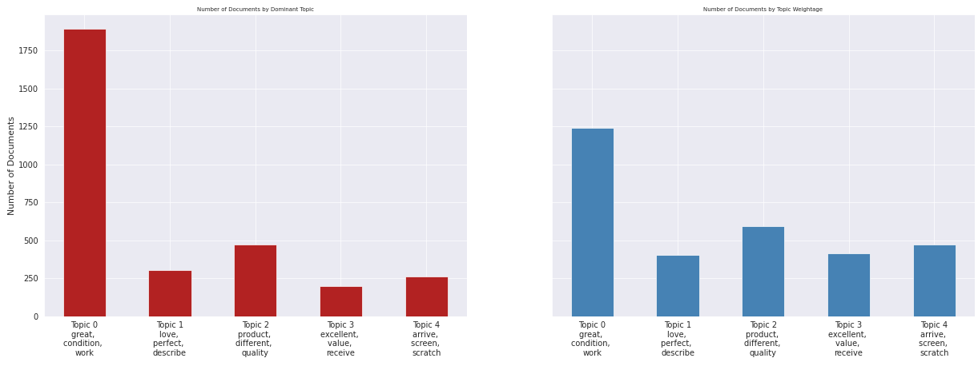
Positive comments
Word cloud
Most Discussed Topics
by dominant topic
by topic weightage
Takeaways:
Users find product to be great buy
Users are positive about the quality
Users like the seller qualities

Slide 18
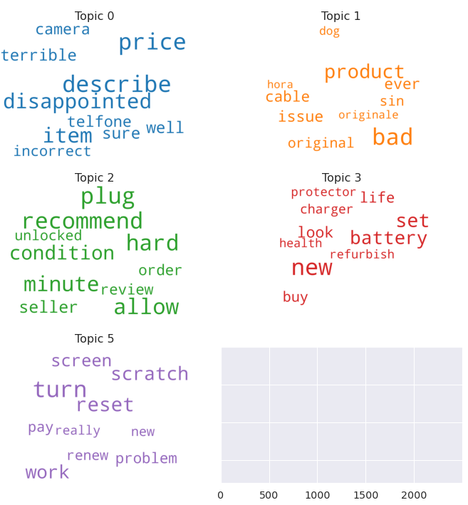
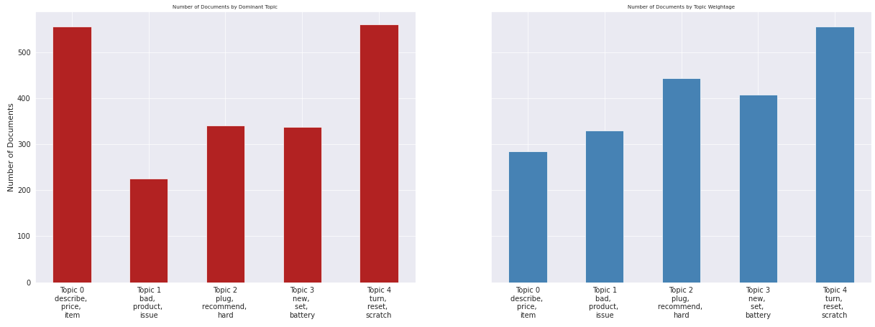
Negative comments
Word cloud
Most Discussed Topics
by dominant topic
by topic weightage
Takeaways:
Users are divided on the priciness of product
Product screen has scratches on arrival
Users have issues with the plug

Slide 19
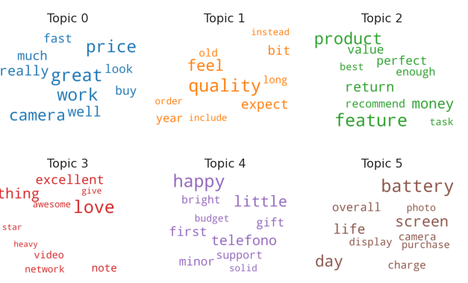
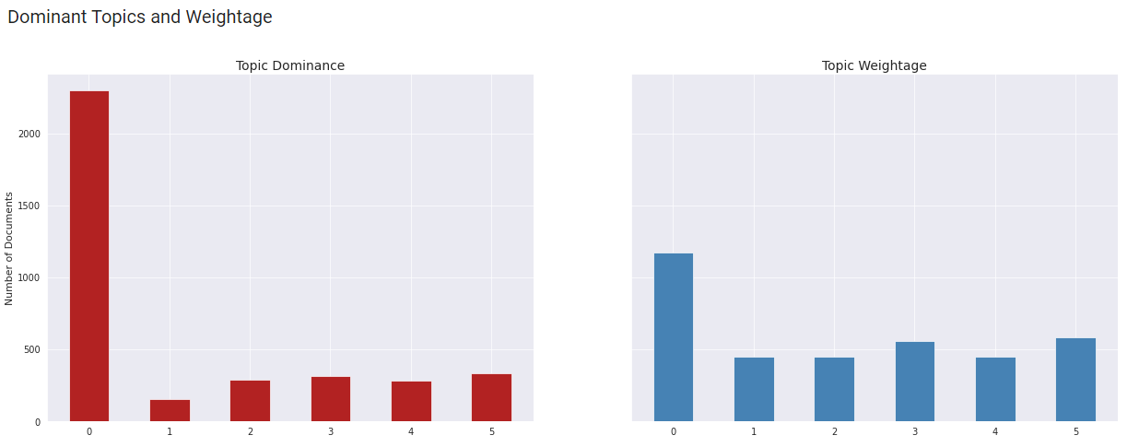
Positive comments
Word cloud
Most Discussed Topics
Takeaways:
Users find the product to be a great value for money
Users like the camera and battery aspects of the product

Slide 20
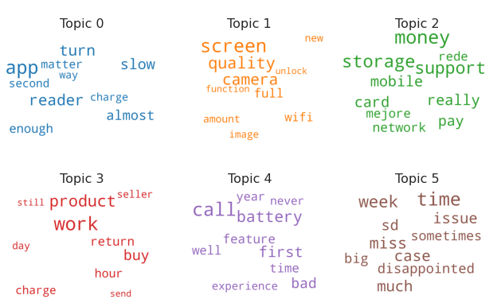
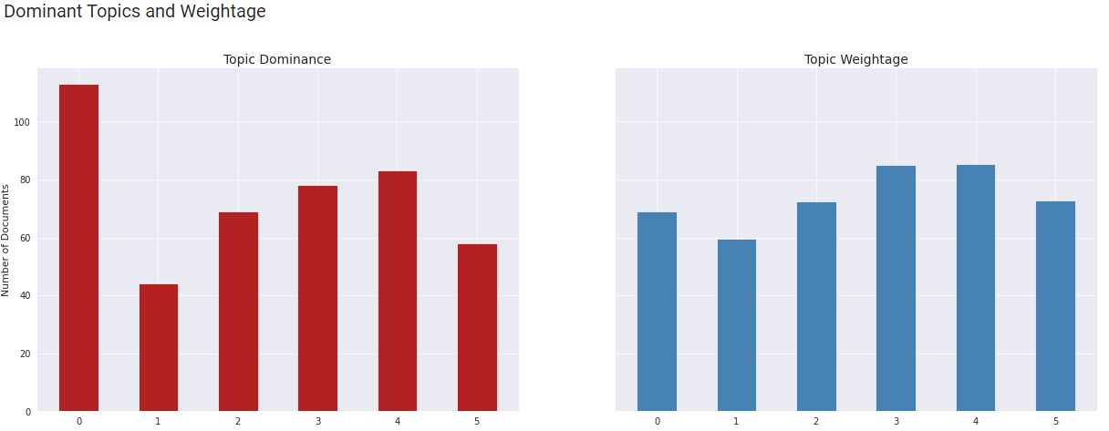
Negative comments
Word cloud
Most Discussed Topics
Takeaways:
Users expect a premium product
Users have issues with the charger and storage

Slide 21
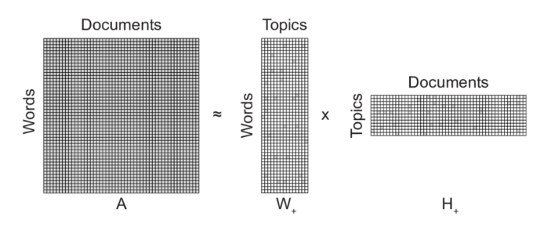
Non Matrix Factorisation
Using linear algebra for topic modeling (in essence)
Input: Term-Document matrix, number of topics.
Output: Two non-negative matrices of the original n words by k topics and those same k topics by the m original documents.
Conceptual illustration of non-negative matrix factorization (NMF) decomposition of a matrix consisting of m words in n documents into two non-negative matrices of the original n words by k topics and those same k topics by the m original documents.

Slide 22
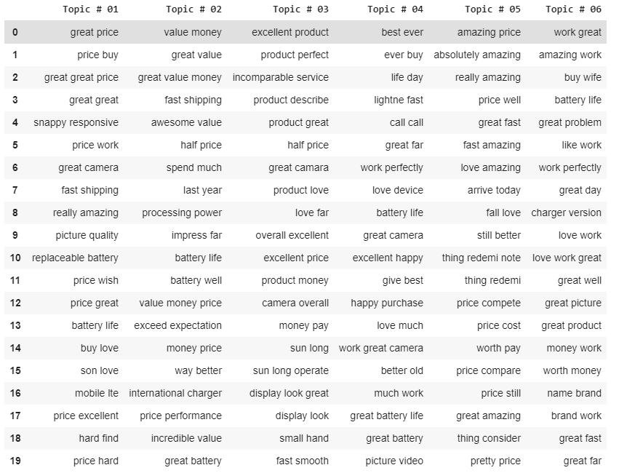
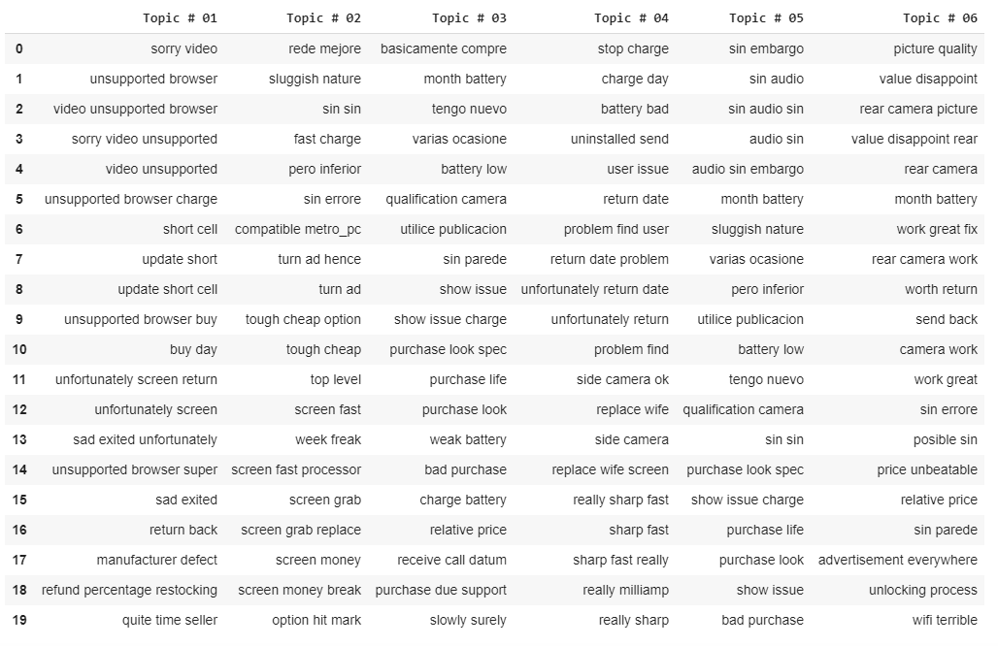
Results of NMF model :

Slide 23
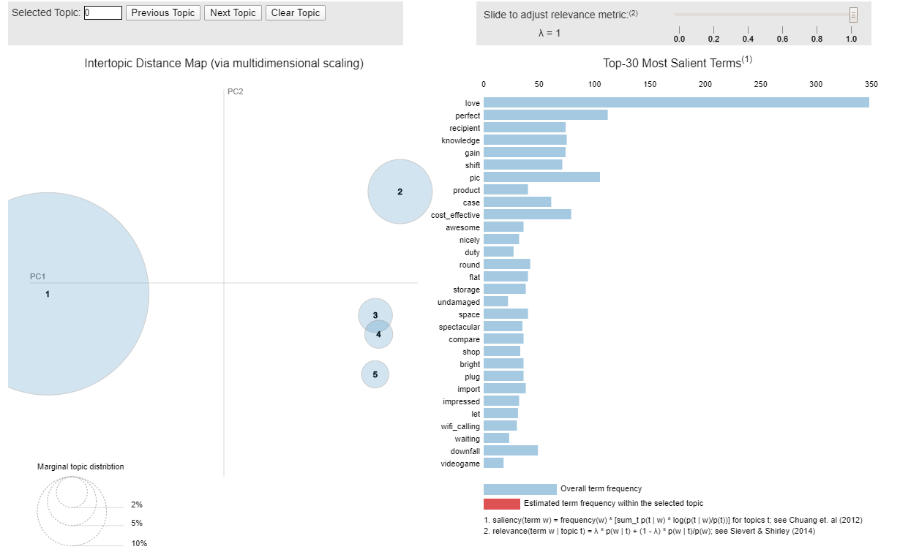
Interactive visualisation from Gensim package
Link to the Google Colab file

Slide 24
Predicting user ratings from their reviews
Models used : Logistic regression, Naïve Bayes, SVM, Random Forest models.
Steps followed:
Convert text data into TF-IDF vectors
Split the data into a training and test set
Classify the text data using different models
Evaluate the performance of each of the models using precision, recall and accuracy.

Slide 25
Predicting user ratings from their reviews
Metrics related to the models mentioned earlier are as given:
 | Logistic Regression |  |  |  |  | SVM
Ratings | Precision | Recall | F1-Score | Support |  | Precision | Recall | F1-Score | Support
1 | 0.68 | 0.71 | 0.69 | 3844 |  | 0.7 | 0.56 | 0.62 | 3844
2 | 0.24 | 0.24 | 0.24 | 1122 |  | 1 | 0 | 0 | 1122
3 | 0.27 | 0.2 | 0.23 | 1409 |  | 0.42 | 0 | 0.01 | 1409
4 | 0.34 | 0.2 | 0.25 | 2606 |  | 0.22 | 0 | 0 | 2606
5 | 0.8 | 0.9 | 0.85 | 11415 |  | 0.66 | 0.99 | 0.79 | 11415
Accuracy |  |  | 0.69 | 20396 |  |  |  | 0.66 | 20396
 | Naive Bayes |  |  |  |  | Random Forest
Ratings | Precision | Recall | F1-Score | Support |  | Precision | Recall | F1-Score | Support
1 | 0.77 | 0.49 | 0.6 | 3844 |  | 0.61 | 0.33 | 0.43 | 3844
2 | 0 | 0 | 0 | 1122 |  | 0.88 | 0.07 | 0.13 | 1122
3 | 0 | 0 | 0 | 1409 |  | 0.92 | 0.07 | 0.13 | 1409
4 | 0.33 | 0 | 0 | 2606 |  | 0.77 | 0.06 | 0.11 | 2606
5 | 0.63 | 1 | 0.77 | 11415 |  | 0.62 | 0.97 | 0.76 | 11415
Accuracy |  |  | 0.65 | 20396 |  |  |  | 0.62 | 20396

